Slide 1

Study of Regression and Classification Models for Energy Consumption Prediction and Outlier Detection Team 11

Slide 2
Introduction
Goal: Predict energy consumption and detect outliers using regression and classification models
Data: Energy consumption data from a house with various appliances
Techniques used: Regression models with SGD, PCA, and regularization; Logistic Regression, Gaussian Naïve Bayes, and Neural Networks for outlier detection; K-fold cross-validation and stacked ensemble model
Evaluation metrics: RMSE, accuracy, precision, recall, and F1 score
Future work: Explore additional features or data sources to improve model performance

Slide 3
Data Description
Dataset: "Appliances energy prediction" dataset from UCI Machine Learning Repository
Features: 29 features including temperature, humidity, wind speed, visibility, and T-dew point
Assumptions: Temperature and humidity in each room are independent of each other, allowing for simplified model focused on predicting energy consumption.

Slide 4
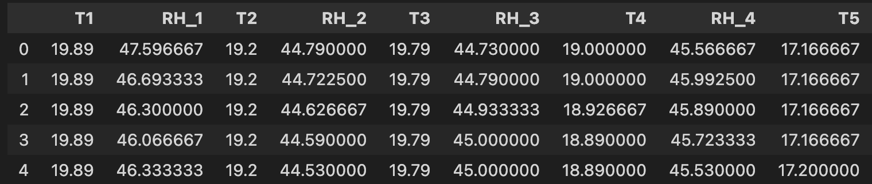
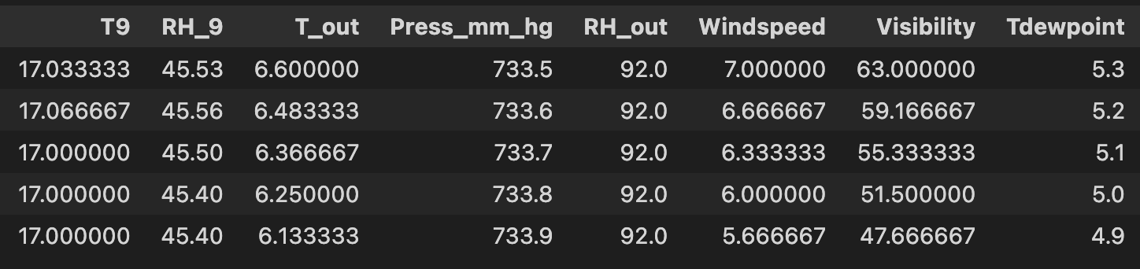
The Dataset

Slide 5
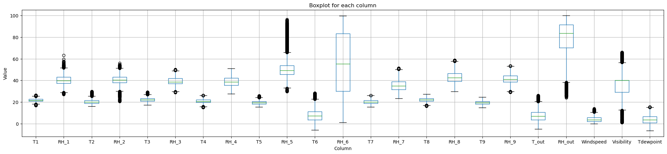
EDA 1

Slide 6
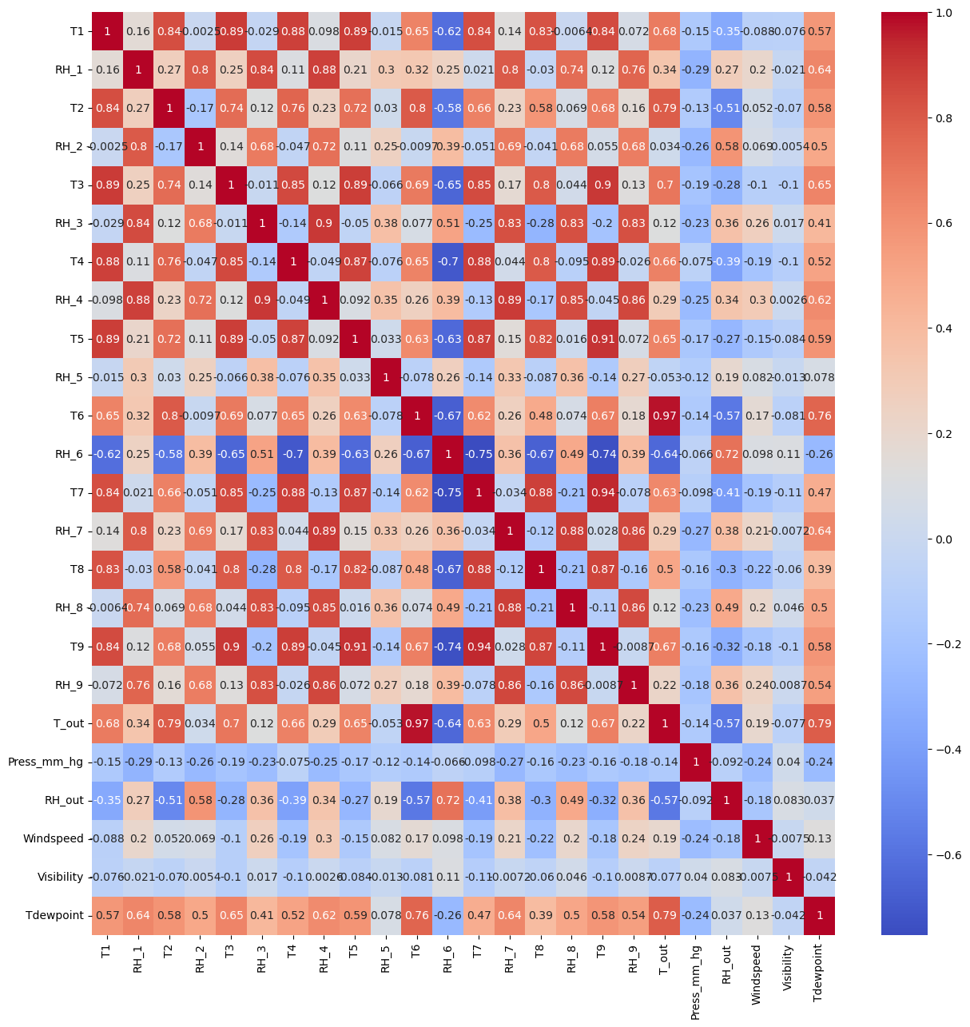
EDA 2

Slide 7
Preprocessing
Preprocessing for regression: Combined "Appliances" and "Lights" to form new feature "usage", dropped unwanted features, separated dataset into X and y, split into train and test datasets
Preprocessing for classification: Combined "Appliances" and "Lights" to form new feature "usage", dropped unwanted features, created new feature for outliers using Z-score method with threshold of 2 standard deviation, performed over-sampling of class 1 to make outliers proportional to non-outliers in training dataset. This method classifies the energy consumption levels of over 320 Wh as outliers (Class 1).

Slide 8
Oversampling
As with any outliers, class 1 (outlier) presence in the data set is heavily imbalanced in comparison to class 0.
To overcome this, we oversampled class 1 using random duplication to reach a balanced presence of class 1 and class 0

Slide 9
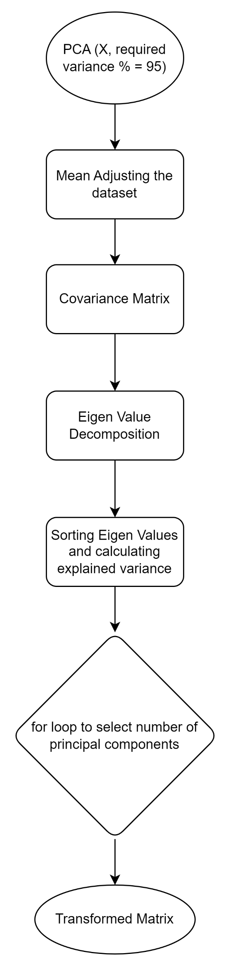
Principal Component Analysis
PCA | Explained Variance | PCA | Explained Variance | PCA | Explained Variance
1 | 68.19355598 | 8 | 98.52698594 | 16 | 99.8663525
2 | 77.1366101 | 9 | 98.96817791 | 17 | 99.90250968
3 | 84.95426102 | 10 | 99.19852654 | 18 | 99.92992919
4 | 90.81630069 | 11 | 99.39575218 | 19 | 99.9530747
5 | 94.61825205 | 12 | 99.54919055 | 20 | 99.96988646
6 | 97.41288076 | 13 | 99.69623548 | 21 | 99.98234862
7 | 98.07668203 | 14 | 99.77228119 | 22 | 99.99015241
8 | 98.52698594 | 15 | 99.8250553 | 23 | 99.99579068

Slide 10
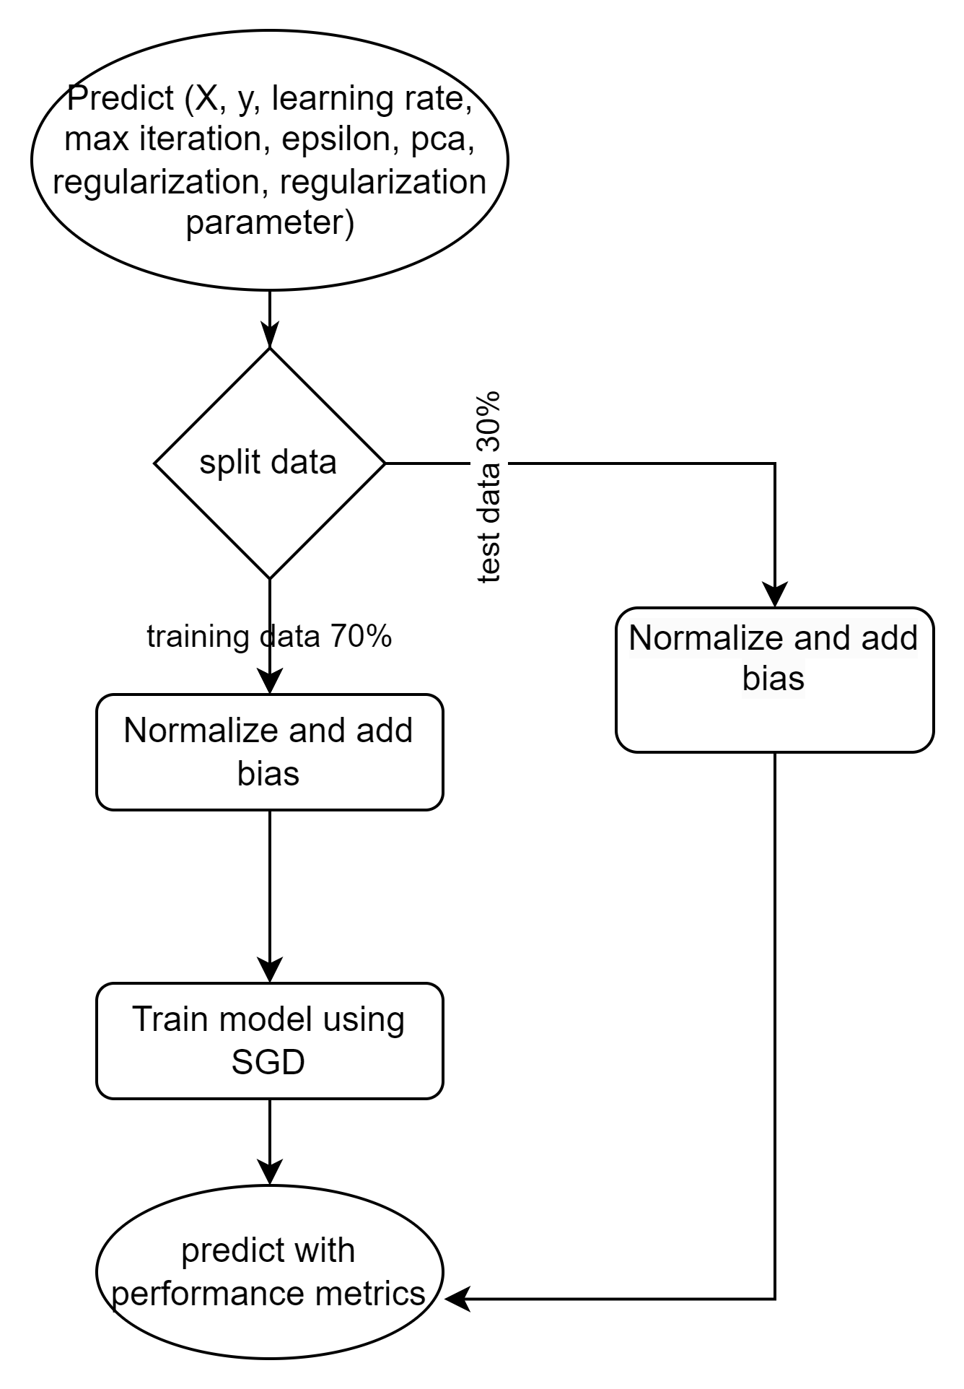
Linear Regression with PCA and Regularization
Regularization Parameter | PCA | Regularization | RMSE
10 | yes | yes | 108.97
10 | no | no | 208.24
10 | yes | no | 107.18
10 | no | yes | 130.22
20 | yes | yes | 111.54
20 | no | no | 119.28
20 | yes | no | 106.34
20 | no | yes | 143.83
30 | yes | yes | 114.26
30 | no | no | 119.67
30 | yes | no | 107.48
30 | no | yes | 128.37

Slide 11
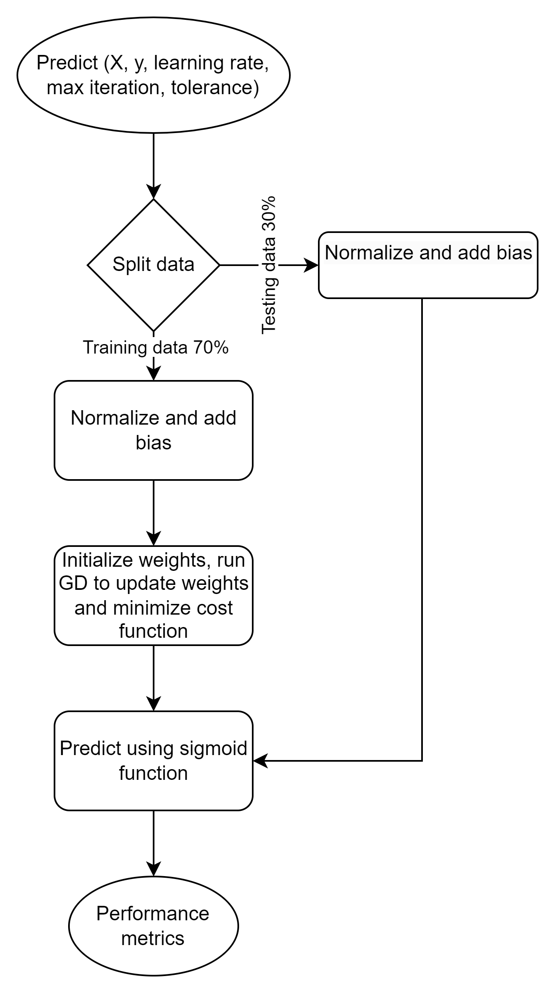
Logistic Regression
Max Iteration | Learning Rate | Accuracy | Precision | Recall | F1 Score
5000 | 0.00001 | 0.66 | 0.66 | 0.67 | 0.67
5000 | 0.0001 | 0.6 | 0.6 | 0.63 | 0.61
5000 | 0.001 | 0.58 | 0.59 | 0.54 | 0.57
5000 | 0.01 | 0.58 | 0.59 | 0.54 | 0.57
5000 | 0.1 | 0.58 | 0.59 | 0.55 | 0.57

Slide 12
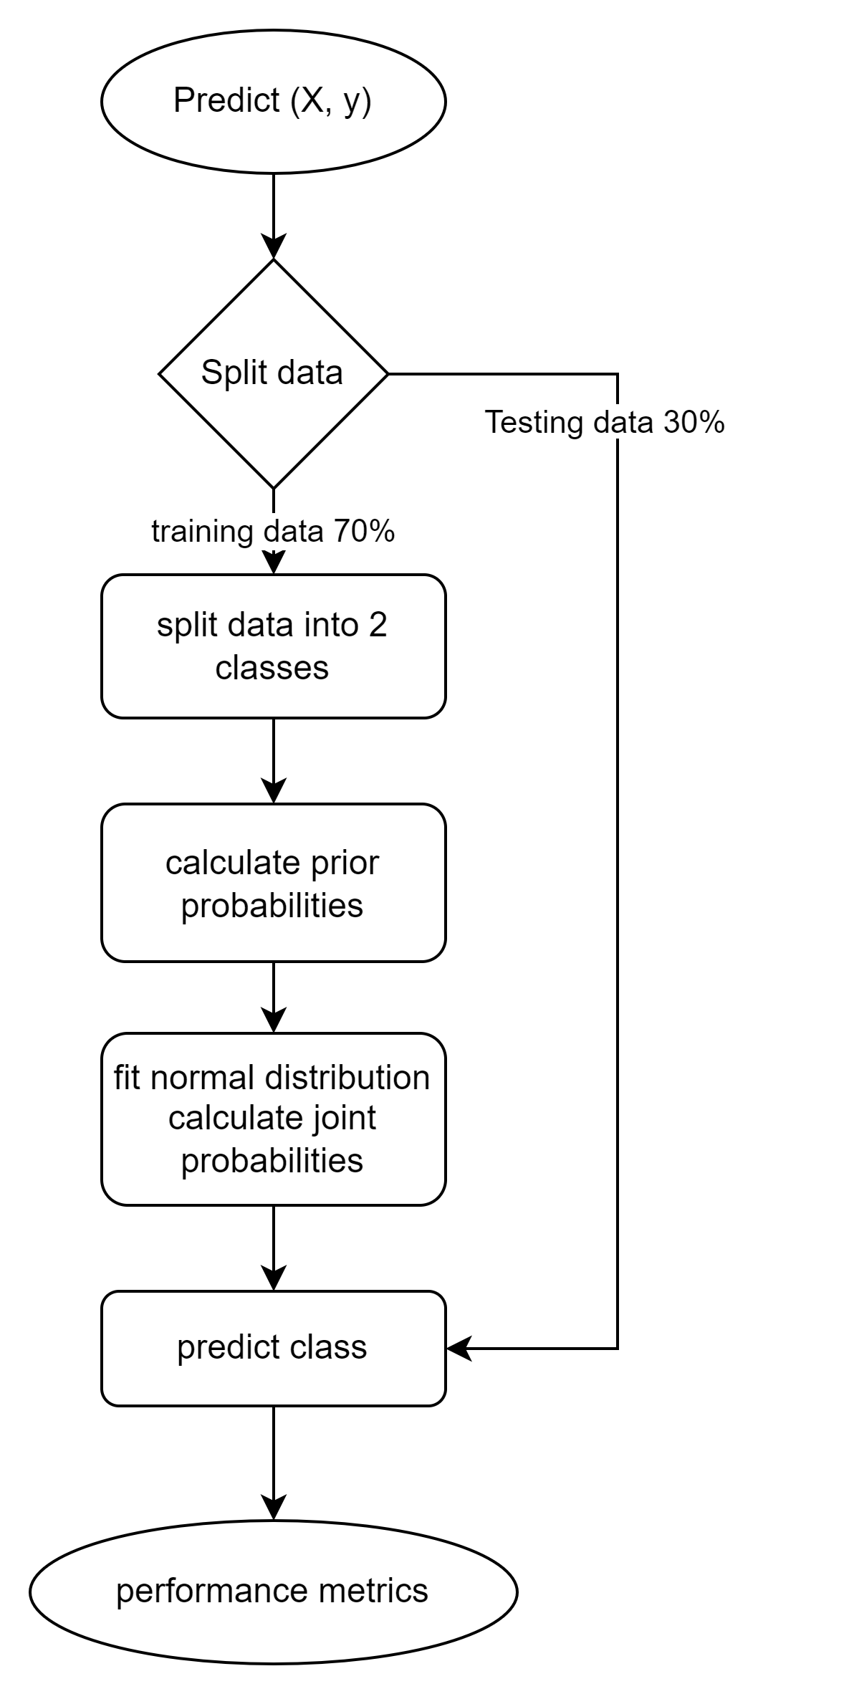
Gaussian Naïve Bayes
Model | Accuracy | Precision | Recall | F1 Score
Gauissian Naïve Bayes | 0.58 | 0.59 | 0.54 | 0.57

Slide 13
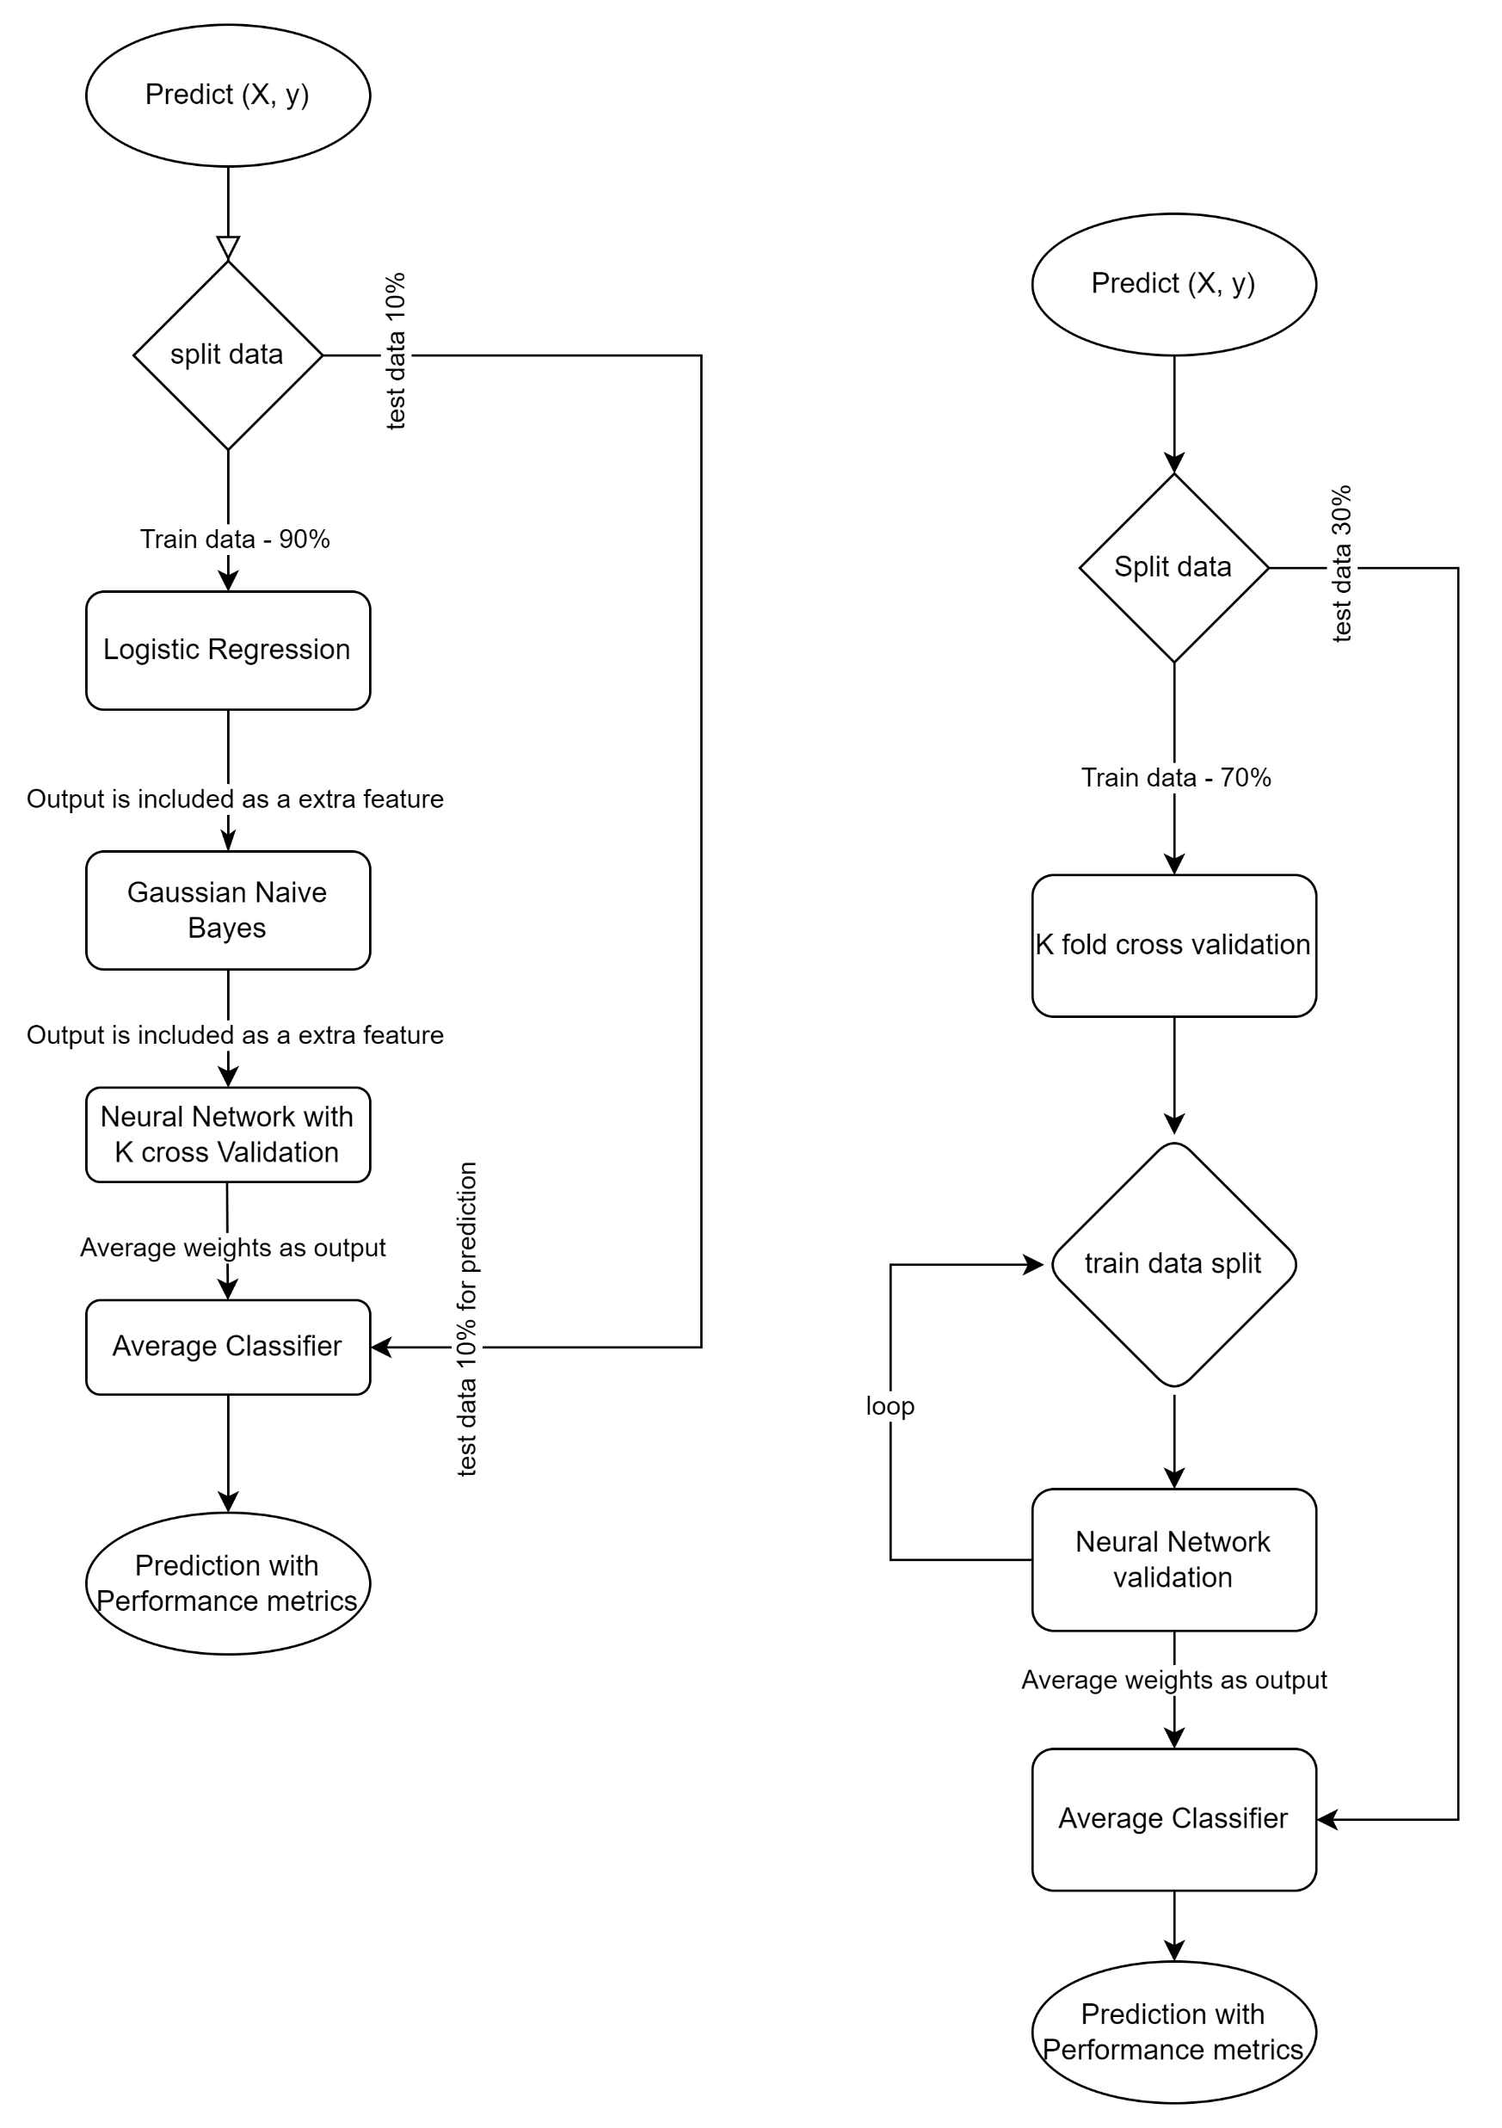
Neural Network with K-fold cross validation & Average Classifier
Epochs | Accuracy | Precision | Recall | F1 Score
5 | 0.74 | 0.72 | 0.81 | 0.76
10 | 0.75 | 0.71 | 0.85 | 0.77
15 | 0.87 | 0.84 | 0.92 | 0.88
20 | 0.89 | 0.84 | 0.96 | 0.90

Slide 14
Stacked Ensemble Model
Dataset | Accuracy | Precision | Recall | F1 Score
Training | 0.889 | 0.868 | 0.917 | 0.892
Test | 0.887 | 0.864 | 0.917 | 0.89

Slide 15
Conclusion
Model | Accuracy | Precision | Recall | F1 Score
Gauissian Naïve Bayes | 0.58 | 0.59 | 0.54 | 0.57
Logistic Regression (Learning Rate = 0.00001, Max Iteration = 5000) | 0.66 | 0.66 | 0.67 | 0.67
Average Classifier (Epochs = 20) | 0.89 | 0.84 | 0.96 | 0.90
Stacked Ensemble (Epochs = 20) | 0.887 | 0.864 | 0.92 | 0.89

Slide 16
Thank you!

